Slide 1
Proiect 1 Structuri de date -sortari
Mirea Oana-Gabriela

Slide 2
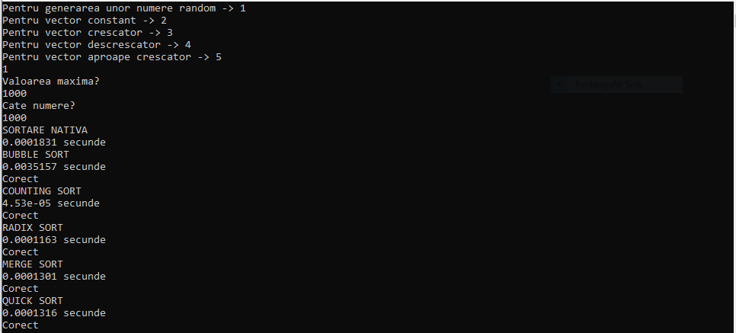
N=10^3,max=10^3, generare random

Slide 3
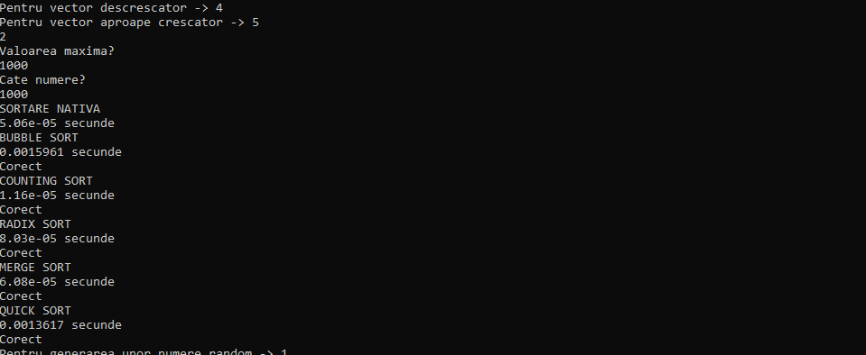
N=10^3,max=10^3,Vector constant

Slide 4
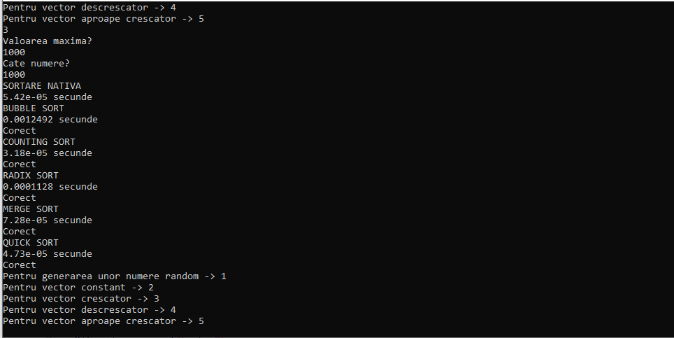
N=10^3,max=10^3,vector crescator

Slide 5
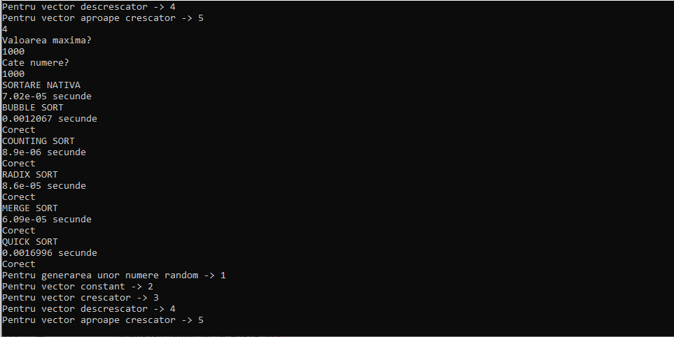
N=10^3,max=10^3, vector descrescator

Slide 6
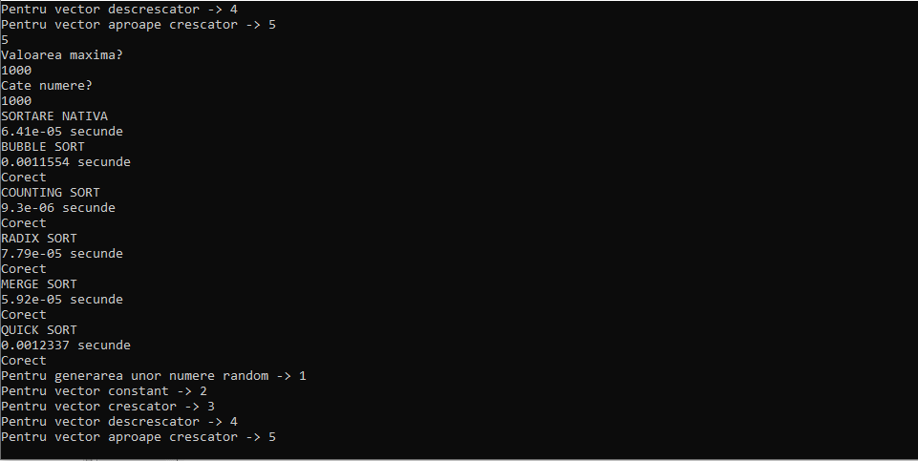
N=10^3,max=10^3,vector aproape crescator

Slide 7
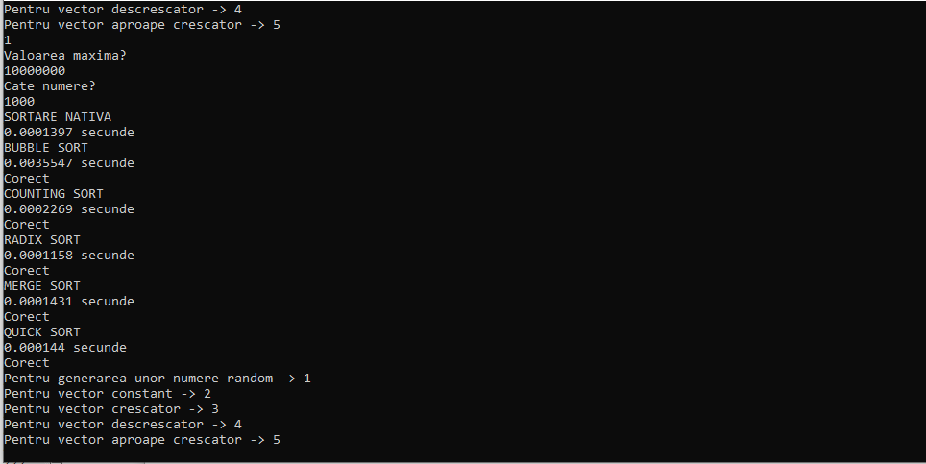
N=10^3,max=10^7, generare random

Slide 8
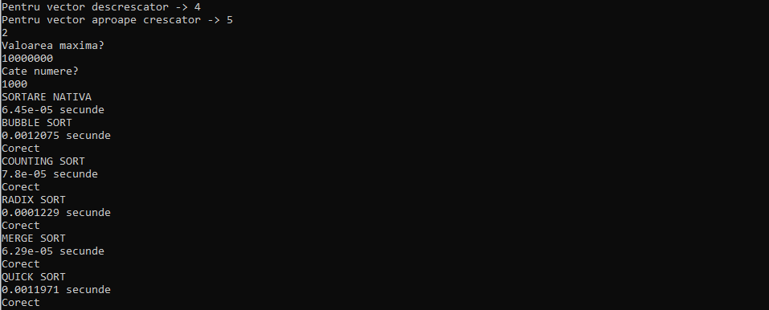
N=10^3,max=10^7, Vector constant

Slide 9
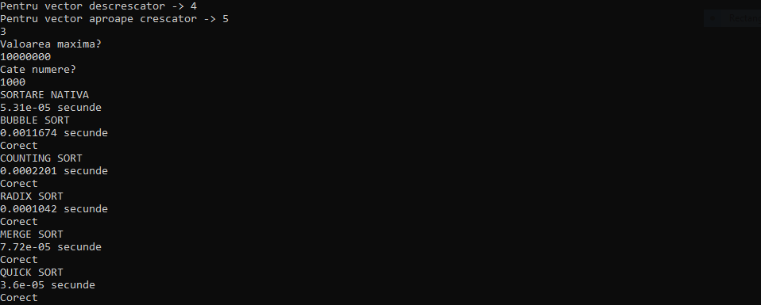
N=10^3,max=10^7, vector crescator

Slide 10
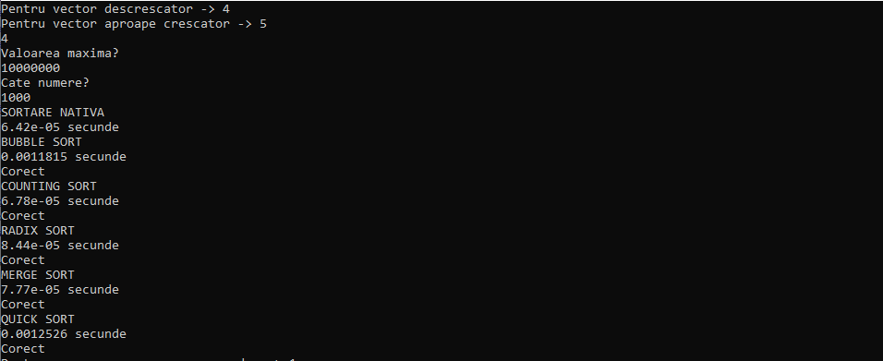
N=10^3,max=10^7, vector descrescator

Slide 11

N=10^3,max=10^7, vector aproape crescator

Slide 12
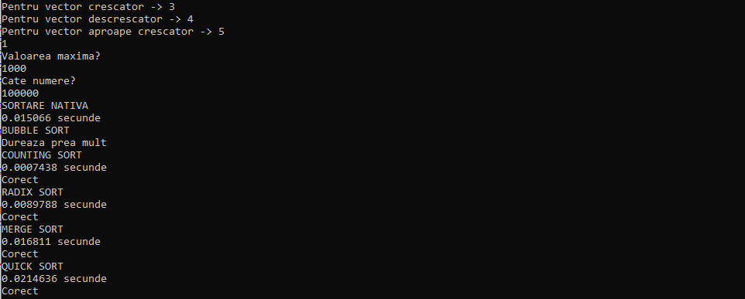
N=10^5,max=10^3, generare random

Slide 13
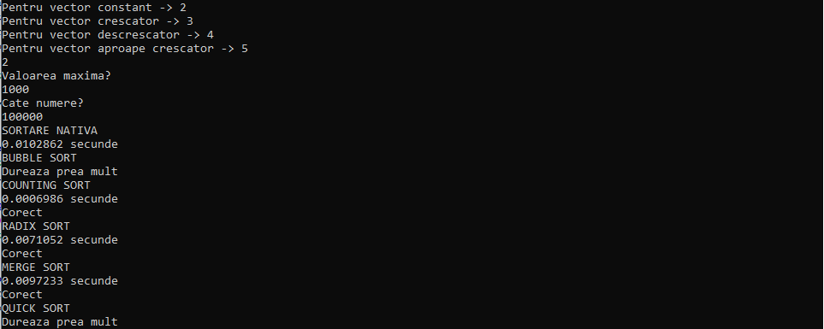
N=10^5,max=10^3, Vector constant

Slide 14
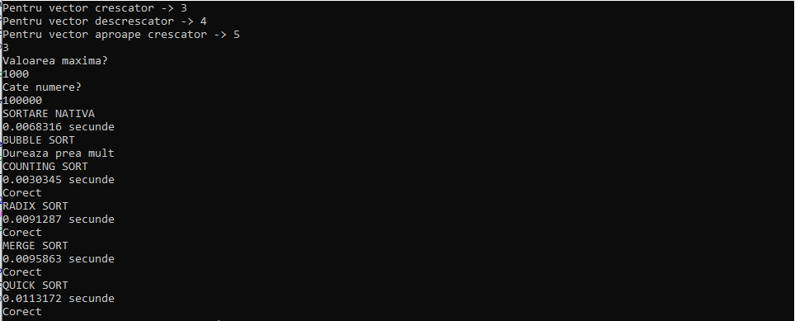
N=10^5,max=10^3, vector crescator

Slide 15
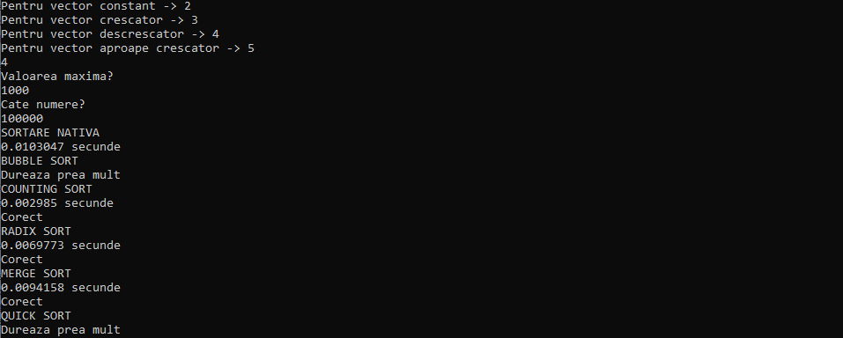
N=10^5,max=10^3, vector descrescator

Slide 16
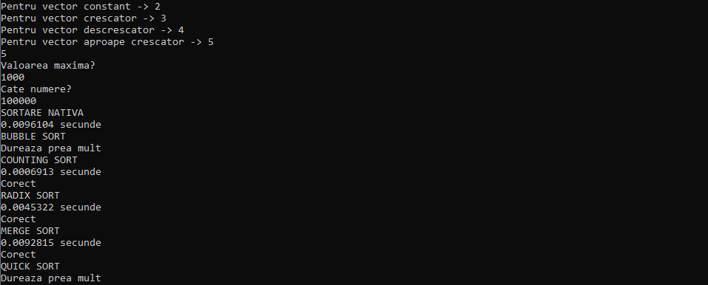
N=10^5,max=10^3, vector aproape crescator

Slide 17
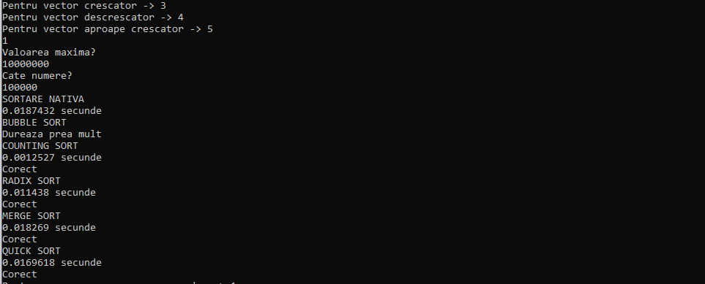
N=10^5,max=10^7, generare random

Slide 18
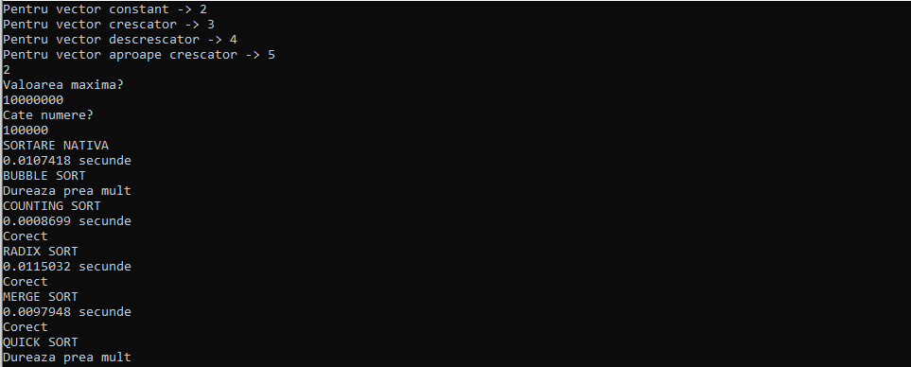
N=10^5,max=10^7, vector constant

Slide 19

N=10^5,max=10^7, vector crescator

Slide 20
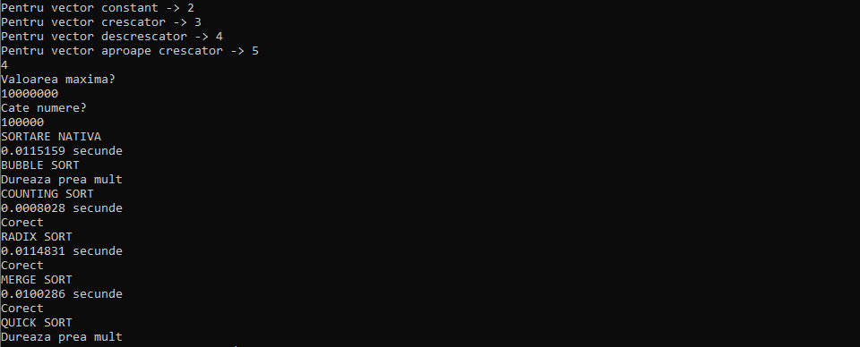
N=10^5,max=10^7, vector descrescator

Slide 21
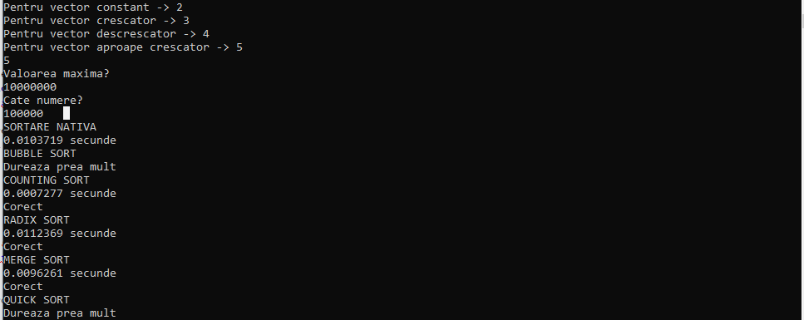
N=10^5,max=10^7, vector aproape crescator

Slide 22
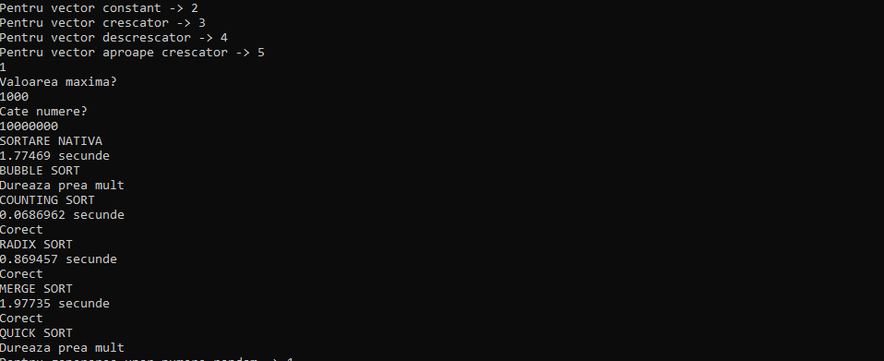
N=10^7,max=10^3, generare random

Slide 23

N=10^7,max=10^3, vector constant

Slide 24
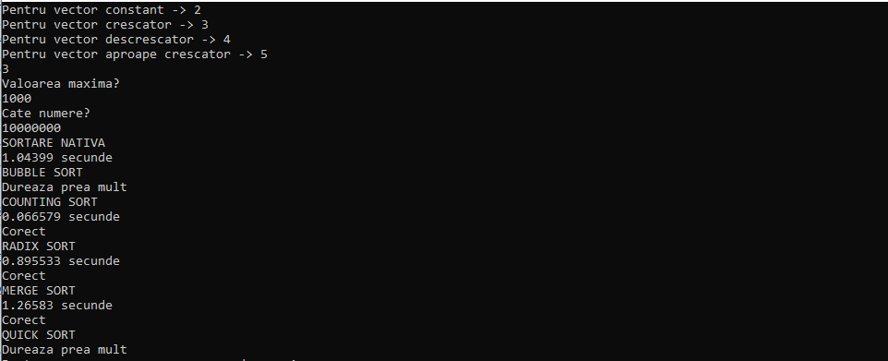
N=10^7,max=10^3, vector crescator

Slide 25
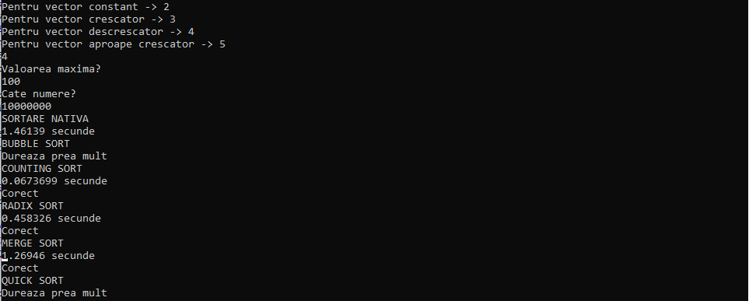
N=10^7,max=10^3, vector descrescator

Slide 26
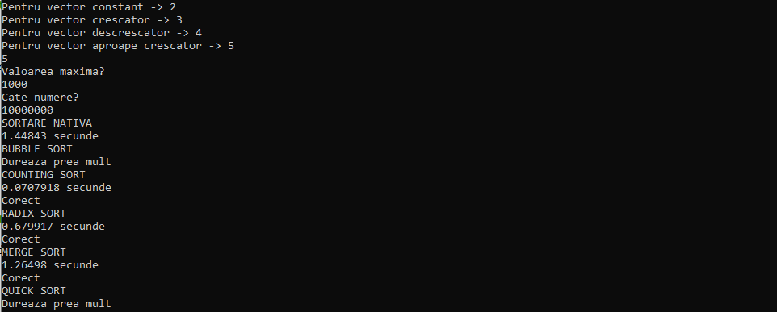
N=10^7,max=10^3, vector aproape crescator

Slide 27
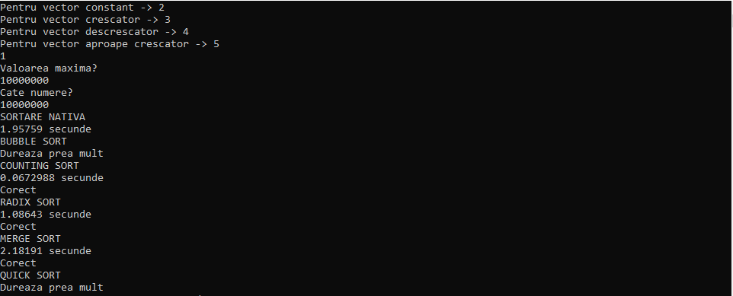
N=10^7,max=10^7, generare random

Slide 28

N=10^7,max=10^7, vector constant

Slide 29
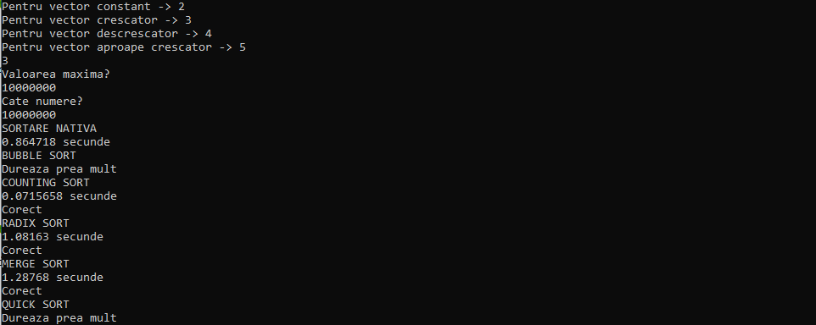
N=10^7,max=10^7, vector crescator

Slide 30
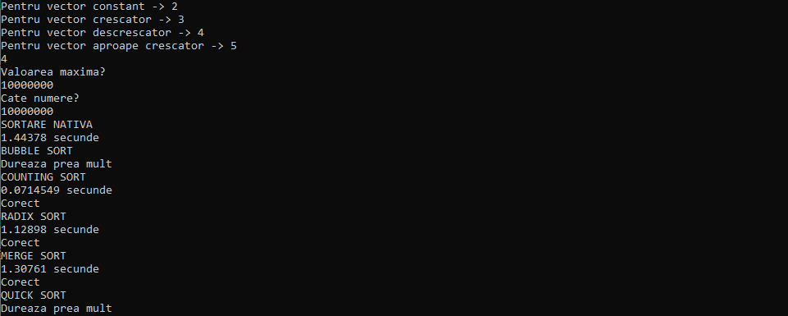
N=10^7,max=10^7, vector descrescator

Slide 31

N=10^7,max=10^7, vector aproape crescator

